Slide 1


PS-1 @ CSIR-IMMT
Rahul Das
2021A8PS2060H
B.E. Electronics and Instrumentation, BITS Pilani, Hyderabad Campus
Working under Dr. Santosh Kumar Behera, Principal Scientist
Assigned under Process Engineering and Instrumentation Department

Slide 2

Introduction
EYE-ON-PELLET : Online Pellet Size Analyzer for Pelletization Industries
Pelletization industries use disc pelletizers to produce pellets of different sizes. However, there is a need of producing pellets of a desired size range, such as 8-18 mm. There is also a need to produce higher percentage pellets in a particular sub size range, such as among 8-18 mm, may be 70% in the range of 8-12 mm (customer requirement).
Helps for timely control of RPM/water/feed-rate(TPI).
Helps in parameter optimization for a new type ore.
Reduces the recycling load & enhances plant productivity.
Non-invasive and cost effective method of size analysis.
Quick installation time.
Can be used in existing and new plants .
Indigenously designed and developed and hence customizable and better after sales service support.
Well tested in most of the leading pelletization plant in India like JSW Steel, currently manufactured by SVNT Infotech, Hyderabad.
Youtube link: https://youtu.be/PL73tOZ15DI?list=TLGGv5uFr-H-cLQxMzA2MjAyMw

Slide 3
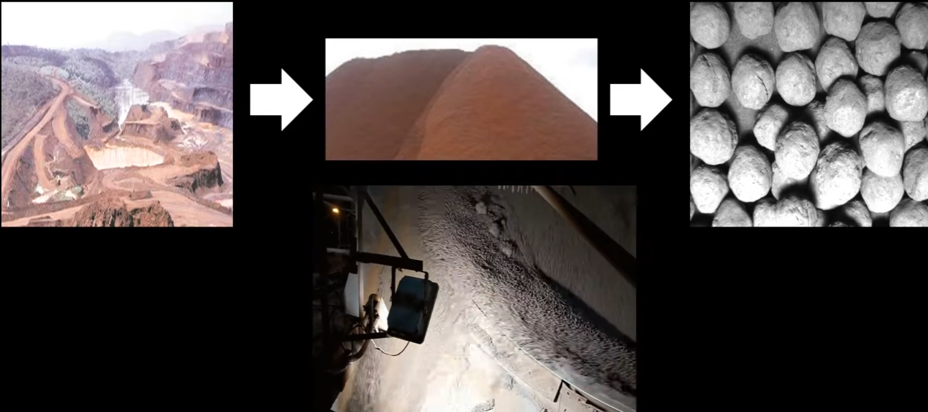
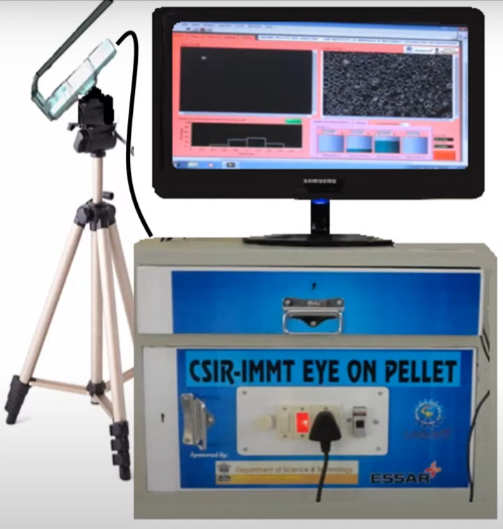
Overview on Iron Pelletization
Pelletization process doesn’t ensure production of equal size ranged pellets continuously.
(Images attached for reference in next slides)
Eye-On-Pellet: Vision based Online Pellet Size Monitoring System
Patent document: https://www.immt.res.in/webroot/upload/admin/document/document_img_1569402114.pdf

Slide 4
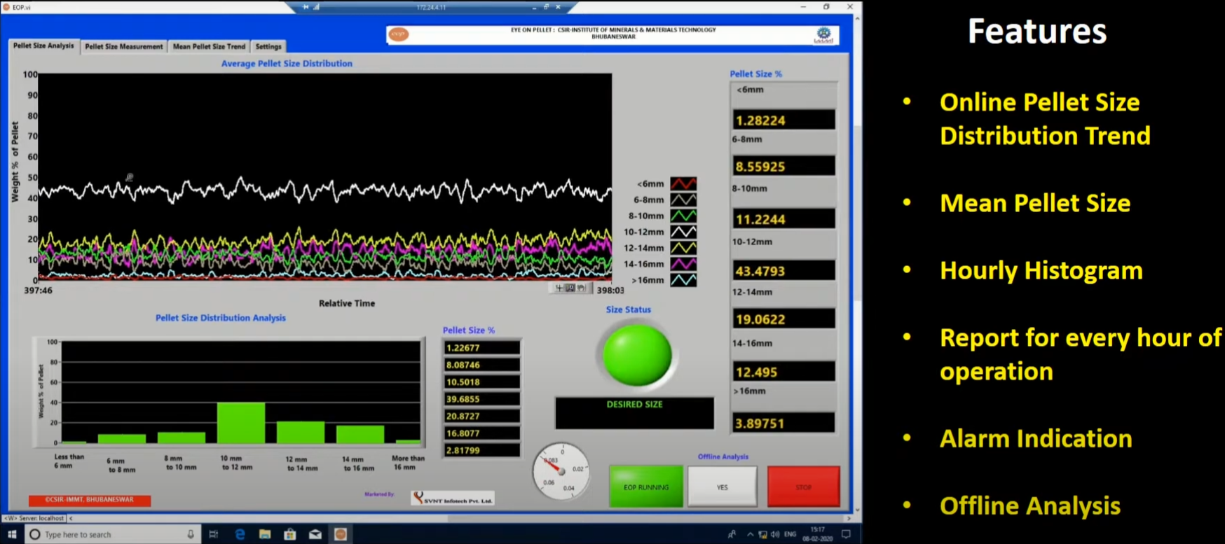
**Image for reference

Slide 5
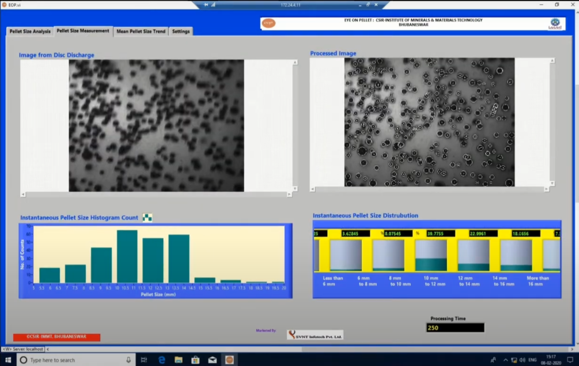
**Image for reference

Slide 6
Objective of project
My objective of the project is to improvise Pellet size analysis by implementing Image Processing on pellet images to extract size and frequency data and applying the best fitting Machine Learning Algorithms for Time Series Forecasting.
Whole program will be written in Python starting from Image detection to applying statistical models. Required specific Python libraries:
OpenCV for Image Processing and pellet detection and their sizes
Scikit-learn for applying Machine Learning algorithms and analysis of collected data
Matplotlib for plotting different sizes in respective histograms etc.
Pandas for easy handling of data structures in Data Frames and using attributes
NumPy for easy manipulation of arrays through pre-coded functions and attributes.

Slide 7
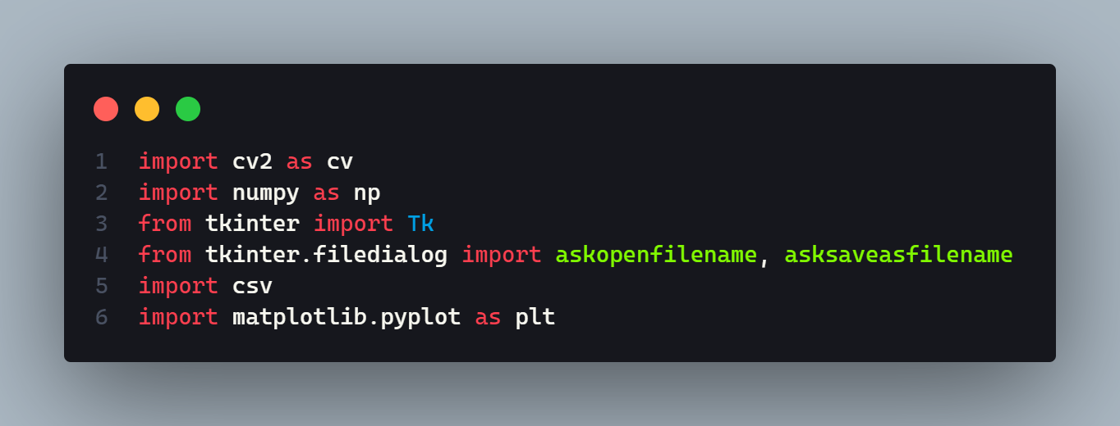
PELLET IMAGE PROCESSING AND DATA RETRIEVAL
cv2: OpenCV library for computer vision and image processing tasks.
numpy: Fundamental package for scientific computing with support for arrays and mathematical functions.
Tk and tkinter.filedialog: Tkinter library for creating GUIs and tkinter.filedialog module for file dialogs.
csv: Built-in module for reading and writing CSV files.
matplotlib.pyplot: Matplotlib library for creating visualizations with a simple interface.

Slide 8
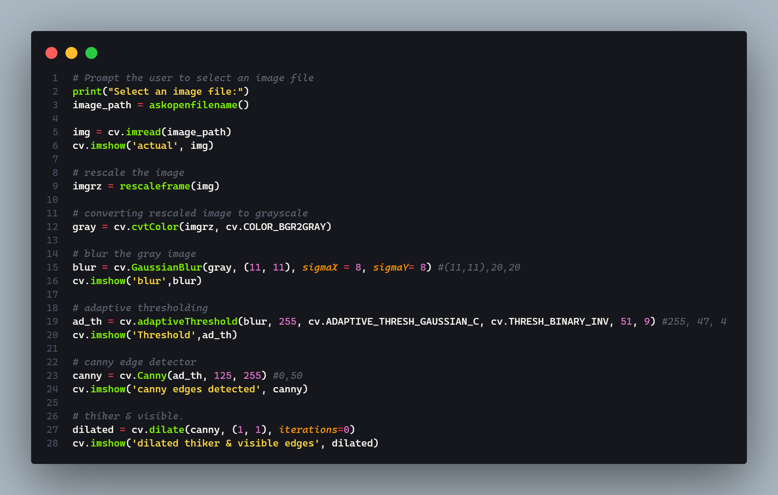
Processing Pellet Images before passing through Hough Circle transform

Slide 9
Rescaling the Image: The rescale_frame() function is used to resize the image, making it smaller or larger based on the given scaling factor.
Converting to Grayscale: The cv.cvtColor() function is used to convert the rescaled image to grayscale. Grayscale images have a single channel representing the intensity values.
Gaussian Blur: The cv.GaussianBlur() function applies a Gaussian blur to the grayscale image. It smoothes out the image by reducing noise and sharp edges, using a kernel of size (11, 11) and a sigma value (step deviation) of 20.
Adaptive Thresholding: The cv.adaptiveThreshold() function performs adaptive thresholding on the blurred image. It calculates the threshold for each pixel based on the local neighborhood, using the Gaussian weighting method. The resulting image is a binary image with white objects on a black background.
Canny Edge Detection: The cv.Canny() function applies the Canny edge detection algorithm to the blurred image. It detects edges in the image by finding regions of significant intensity changes. The resulting image is a binary edge map.
Dilate Image: The cv.dilate() function is used to thicken and make the edges more visible in the binary image. It expands the white regions by applying a morphological operation with a (1, 1) kernel.

Slide 10
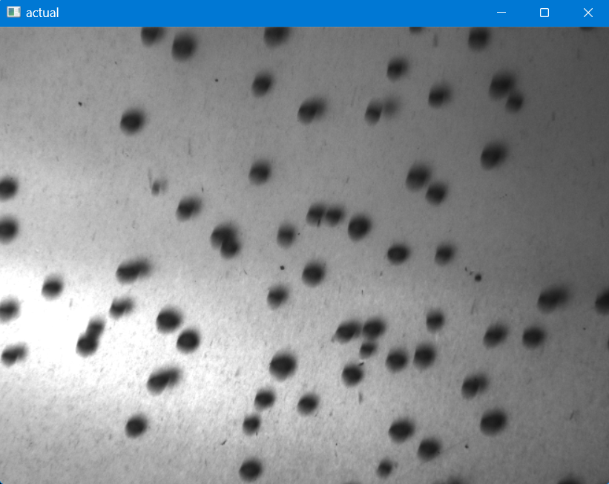
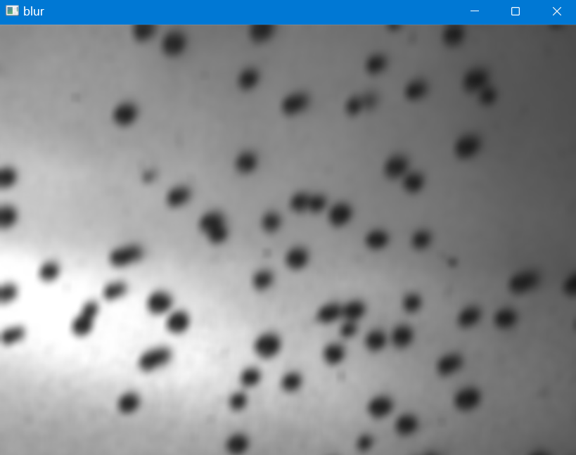
Image after Guassian Smoothing Kernel size = (11,11) SigmaX = 20
SigmaY = 20

Slide 11
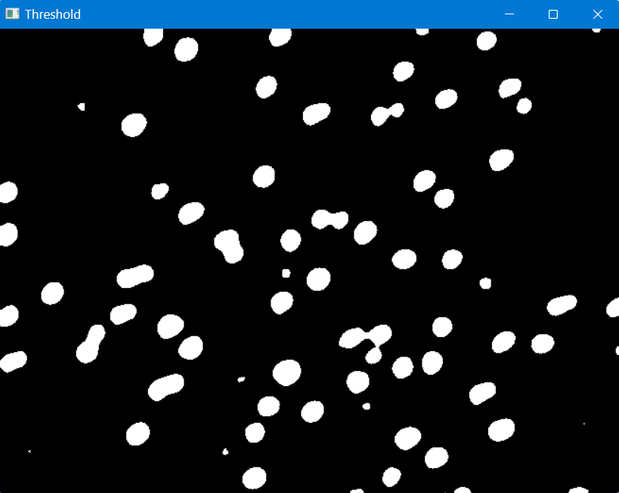
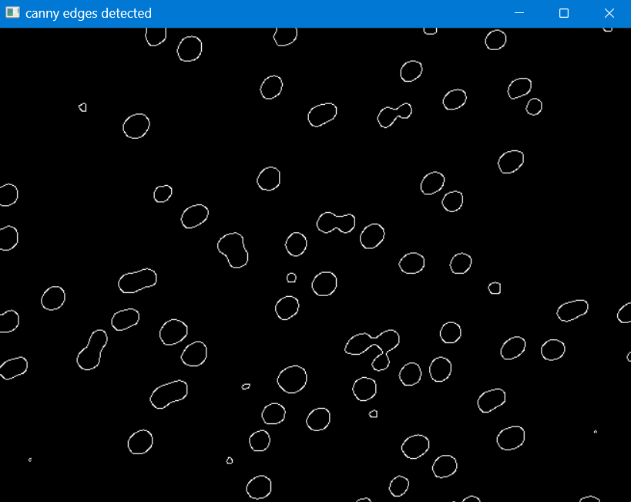
Adaptive Thresholding on blurred image
Max value = 255
Blocksize = 51
Constant = 9
Canny Edge detection on thresholded image
Threshold1 = 0
Threshold2 = 50
threshold1: It is the first threshold value used in the Canny edge detection algorithm. This value represents the lower threshold for gradient intensity. Any edge with a gradient magnitude larger than threshold1 will be considered as a potential edge pixel.
threshold2: It is the second threshold value used in the Canny edge detection algorithm. This value represents the upper threshold for gradient intensity. Any edge with a gradient magnitude smaller than threshold2 will be suppressed and considered as a non-edge pixel.
Pixels with gradient magnitudes between threshold1 and threshold2 are considered as weak edges. They will be included in the final edge map only if they are connected to strong edges (pixels with gradient magnitudes higher than threshold2).

Slide 12
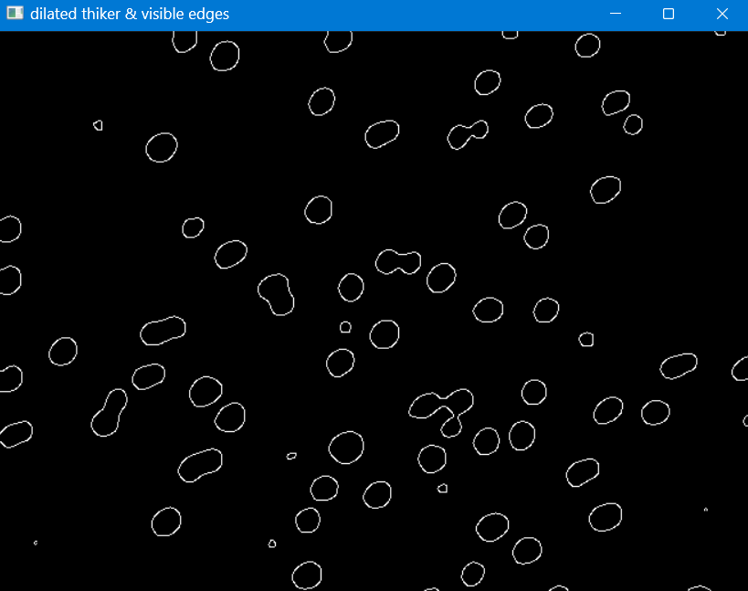
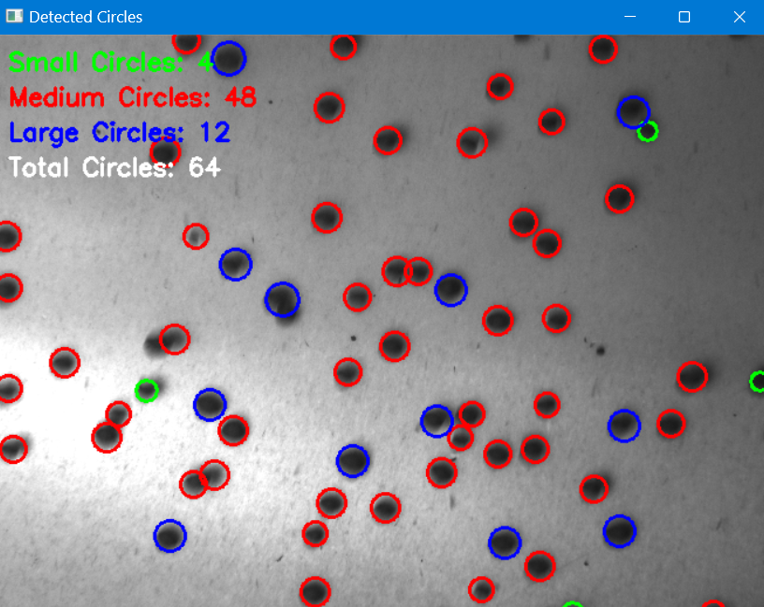

Slide 13
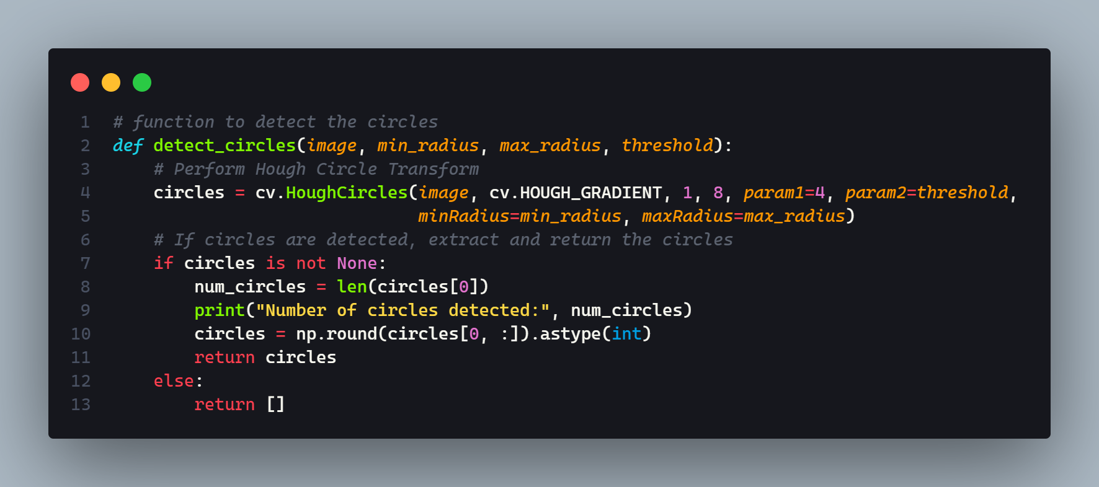
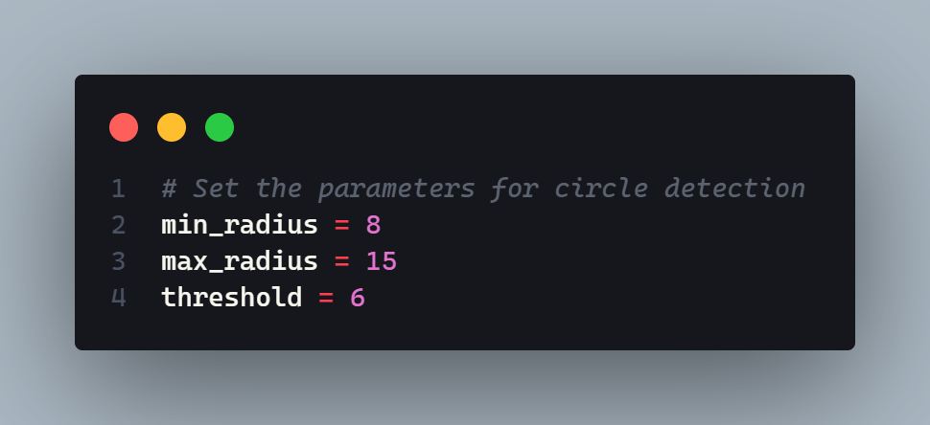
Circle detection function using Hough Circle Transform and plotting of Circles on original image
circles = cv.HoughCircles(image, cv.HOUGH_GRADIENT, dp, minDist, param1, param2, minRadius, maxRadius)
The cv.HOUGH_GRADIENT method uses a two-stage procedure for circle detection. In the first stage, it applies the Canny edge detection algorithm to the input image to identify potential edge pixels. Then, it applies the Hough Transform to detect circles based on the identified edge pixels.
This method is computationally efficient and works well in most scenarios where the circles are well-defined and have sufficient contrast with the background.

Slide 14
Parameters of Hough Circle Detection
dp: This parameter represents the inverse ratio of the accumulator resolution to the image resolution. A smaller value of dp means a higher resolution in the accumulator. Typically, dp=1 indicates the same resolution as the input image, while dp=2 halves the resolution. It helps in determining the sensitivity of the circle detection algorithm.
minDist: It is the minimum distance between the centers of detected circles. If the detected circles are too close to each other, only one of them will be returned. This parameter helps in eliminating duplicate or overlapping circles.
param1: This is the upper threshold for the internal Canny edge detection used in the circle detection algorithm. It determines the quality of the detected edges. Higher values of param1 will result in more precise edge detection but may also lead to missing some weak edges.
param2: It is the accumulator threshold for the circle centers at the detection stage. The smaller the value, the more circles will be detected, but many of them may be false positives. Increasing the value helps in reducing false detections.
minRadius: It specifies the minimum radius of the circles to be detected. Circles with a radius smaller than this value will not be considered.
maxRadius: It represents the maximum radius of the circles to be detected. Circles with a radius larger than this value will not be considered.
These parameters are used in the cv.HoughCircles() function to control the behavior of the Hough Circle Transform algorithm and fine-tune the circle detection process.

Slide 15
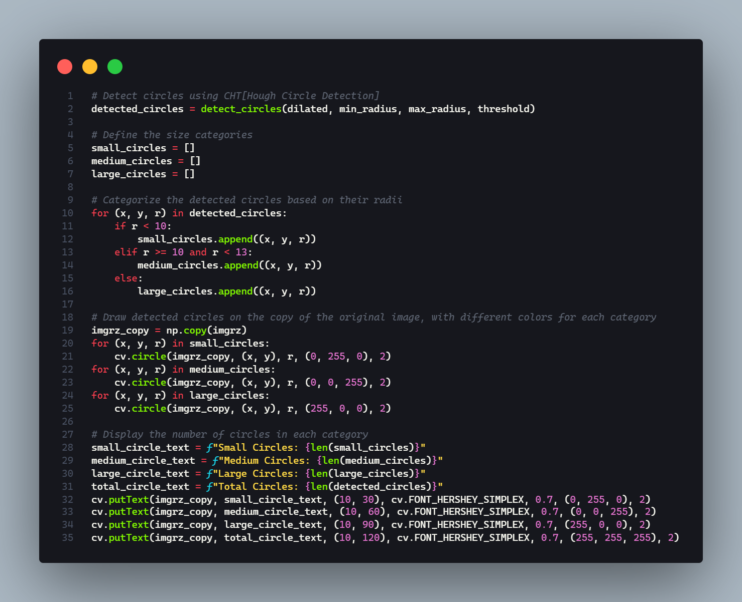
Size categorization and drawing detected circles over original image after Hough Circle Transform
cv.circle(img,centre,radius,color,thickness,shift)
Draws a circle on the image passed in the function

Slide 16
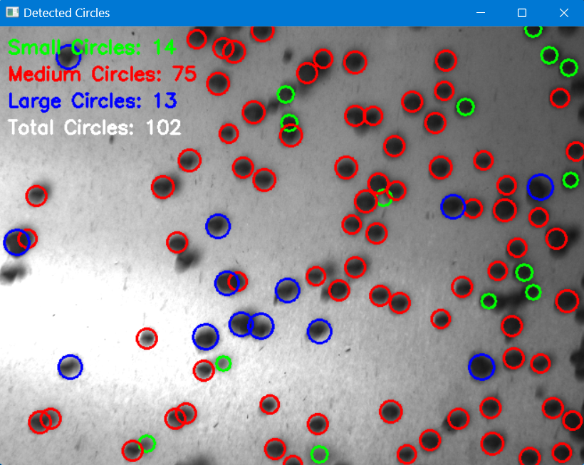
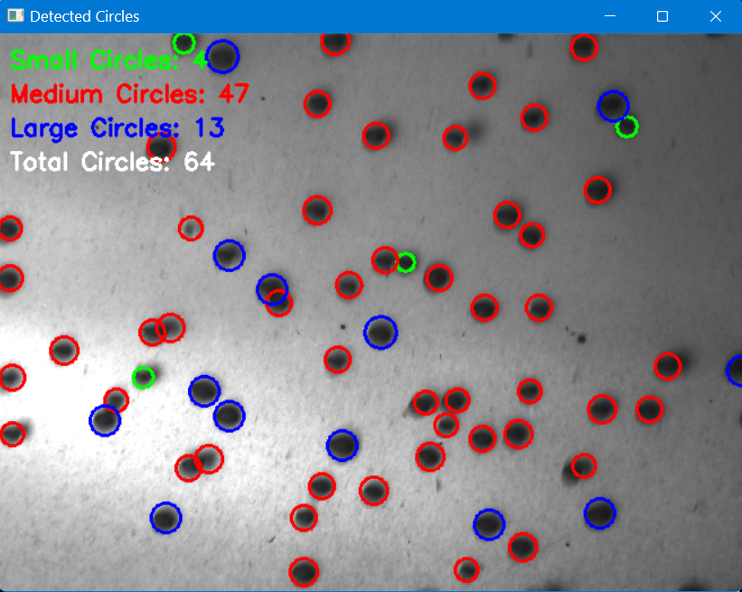
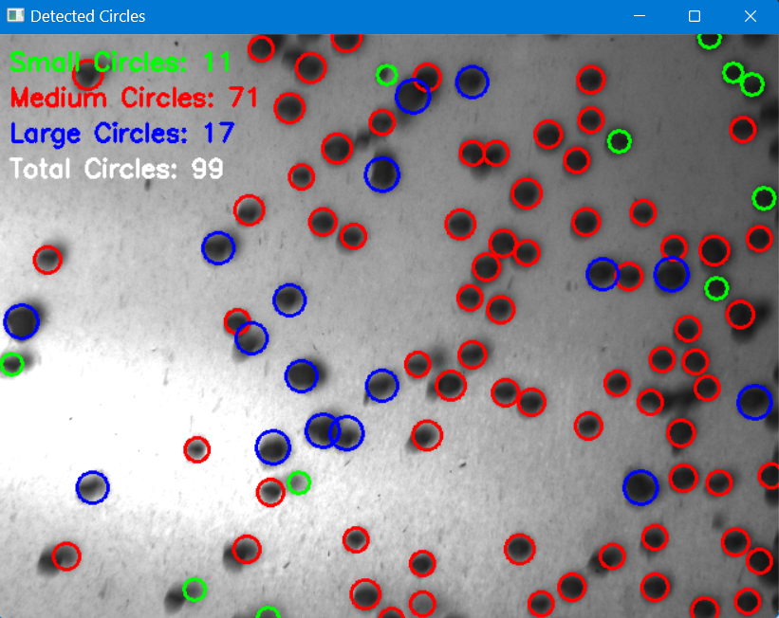
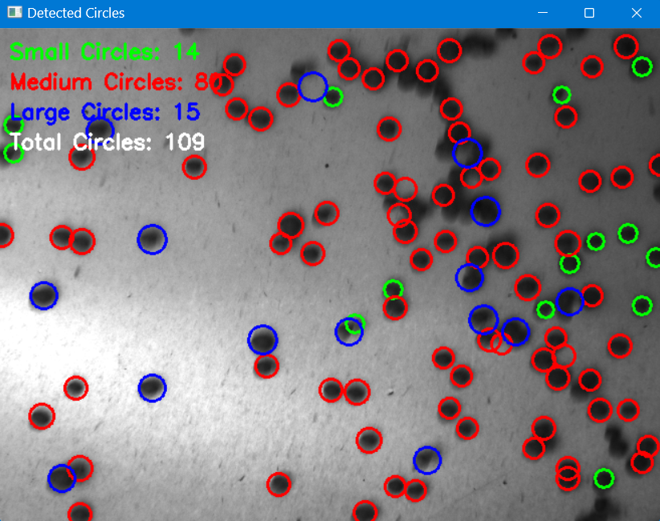

Slide 17
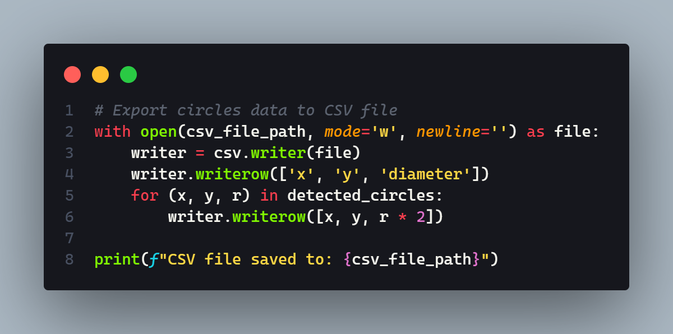
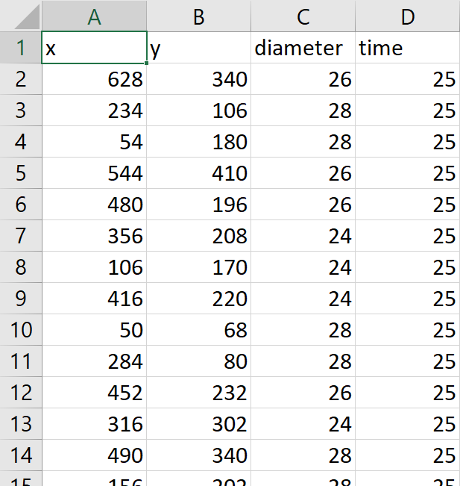
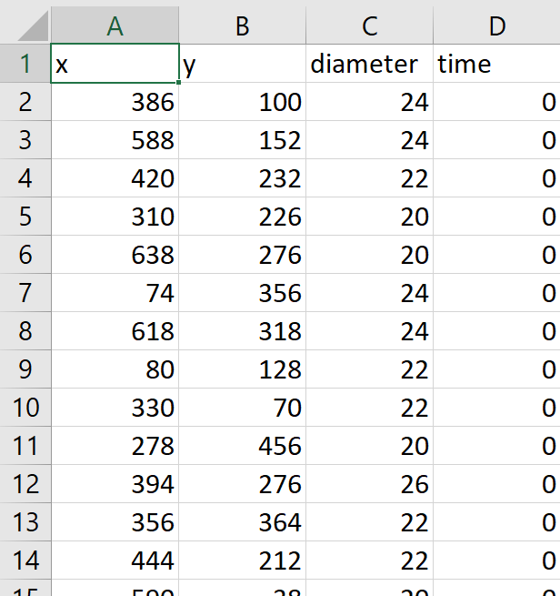
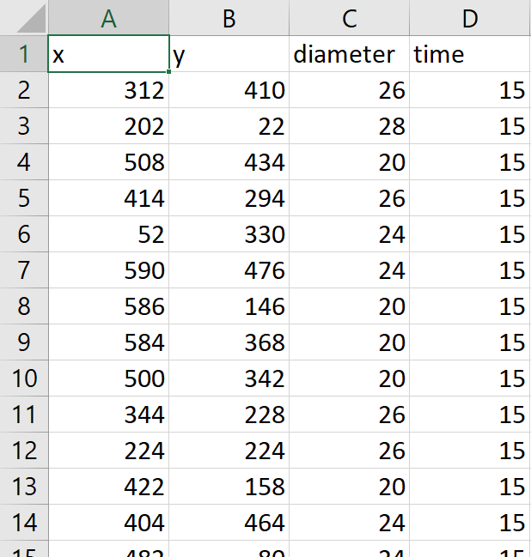
EXPORTING DATA INTO .CSV FILES
Pellet Coordinates, Diameter, Time of Capture in .csv format (viewing in excel)

Slide 18
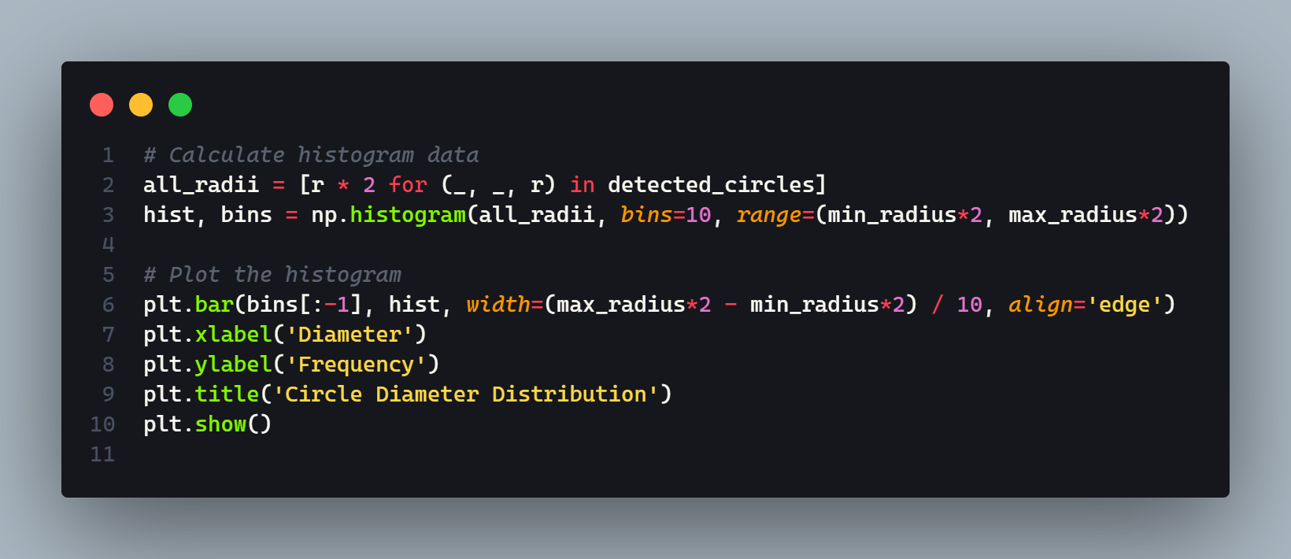
Plotting size distribution plots for judging behavioural patterns

Slide 19
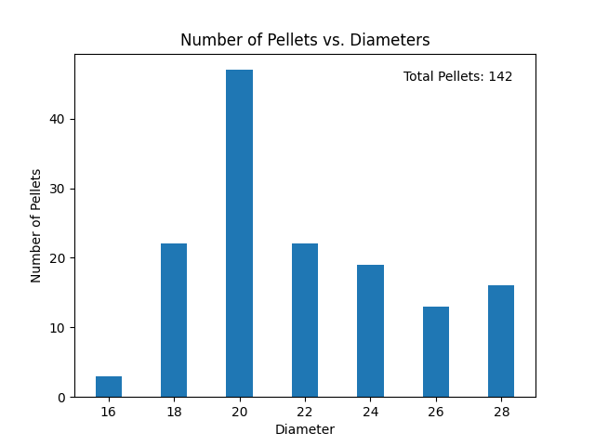
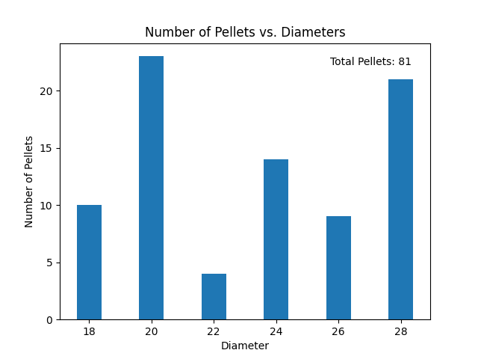
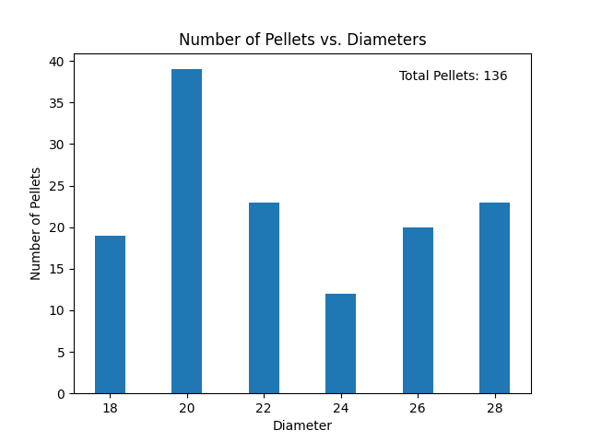
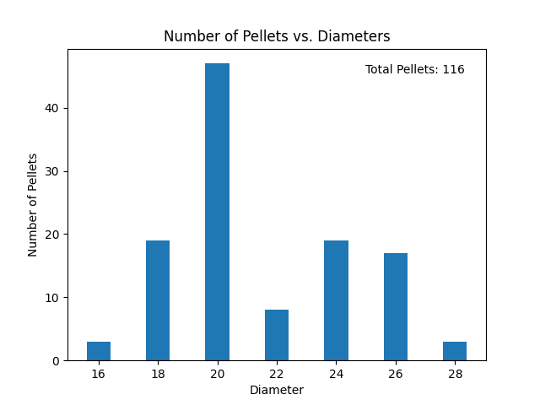
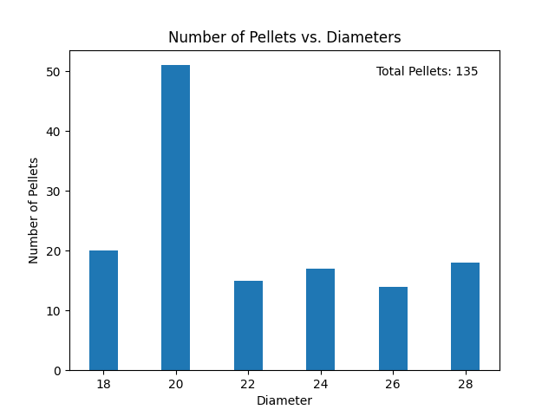
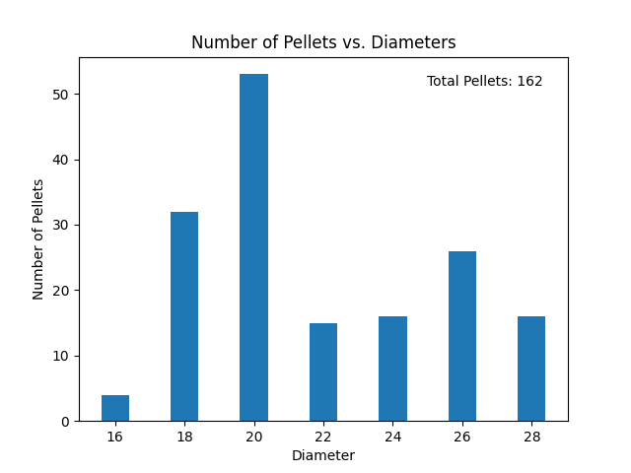
Size distribution plots of 6 sample images

Slide 20
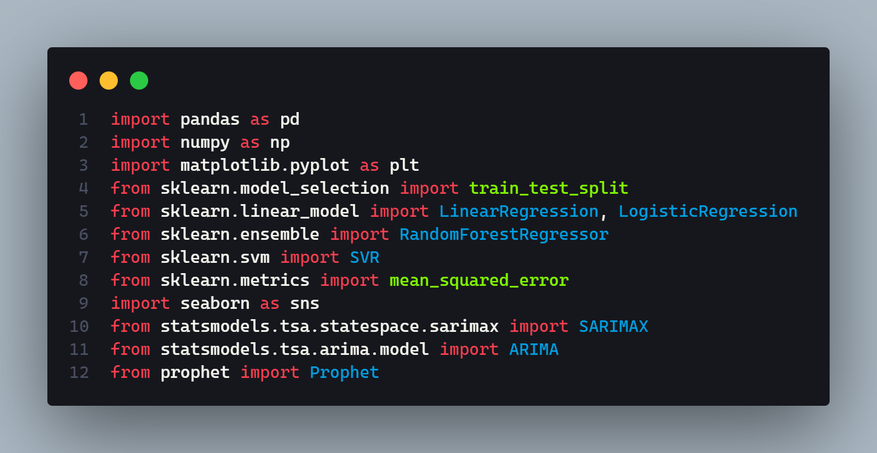
DATA ANALYSIS AND FORECASTING
These imported libraries and modules provide a range of functionalities and algorithms for data analysis, machine learning, time series analysis, and visualization, which are used in the code for various tasks.

Slide 21
TOOLS IMPORTED
pandas as pd: It provides data structures and data analysis tools for working with structured data, such as tabular data in the form of DataFrames.
numpy as np: It is used for numerical computations in Python and provides support for working with multi-dimensional arrays and various mathematical operations.
matplotlib.pyplot as plt: This imports the pyplot module from the matplotlib library and assigns it the alias plt. Matplotlib is a popular plotting library in Python, and pyplot provides a simple interface for creating various types of plots and visualizations.
sklearn.model_selection.train_test_split: This imports the train_test_split function from the model_selection module of the scikit-learn library. This function is used to split data into training and testing subsets for machine learning models.

Slide 22
sklearn.linear_model.LinearRegression, sklearn.linear_model.LogisticRegression: This imports the LinearRegression and LogisticRegression classes from the linear_model module of scikit-learn. These classes are used for linear regression and logistic regression, respectively.
sklearn.ensemble.RandomForestRegressor: This imports the RandomForestRegressor class from the ensemble module of scikit-learn. This class represents the random forest regression model, which is an ensemble learning method based on decision trees.
sklearn.svm.SVR: This imports the SVR class from the svm module of scikit-learn. SVR stands for Support Vector Regression, which is a type of regression model that uses support vector machines.
sklearn.metrics.mean_squared_error: This imports the mean_squared_error function from the metrics module of scikit-learn. This function is used to calculate the mean squared error, which is a common evaluation metric for regression models.

Slide 23
seaborn as sns: This imports the seaborn library and assigns it the alias sns. Seaborn is a high-level interface for creating informative and visually appealing statistical graphics in Python. It provides additional plotting functions and themes built on top of matplotlib.
statsmodels.tsa.statespace.sarimax.SARIMAX: This imports the SARIMAX class from the statespace module of the statsmodels library. SARIMAX represents the Seasonal AutoRegressive Integrated Moving Average with eXogenous regressors model, which is used for time series forecasting and analysis.
statsmodels.tsa.arima.model.ARIMA: This imports the ARIMA class from the model module of the statsmodels library. ARIMA represents the AutoRegressive Integrated Moving Average model, another popular model for time series analysis and forecasting.
prophet.Prophet: This imports the Prophet class from the prophet module. Prophet is a forecasting library developed by Facebook that uses an additive model to make time series forecasts, and it is known for its ease of use and ability to handle various types of seasonality.

Slide 24
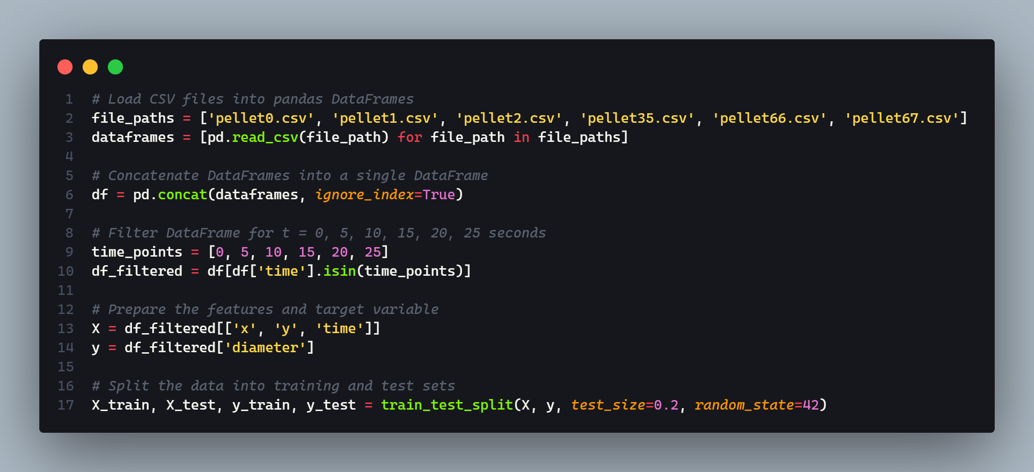
Random state: The specific value of the random_state parameter is not relevant in terms of its numeric value; what matters is that you use the same value consistently to achieve reproducibility in your code.
Load data: The code loads data from several CSV files into pandas DataFrames. The file paths for the CSV files are specified in a list.
Concatenate DataFrames: The DataFrames are concatenated into a single DataFrame using the pd.concat() function, with the ignore_index parameter set to True to reset the index.
Filter DataFrame: The resulting DataFrame is filtered for specific time points using the isin() method. The time points are specified in a list and the DataFrame is filtered to only include rows where the time column value is in this list.
Prepare features and target variable: The features and target variable are prepared for modeling. The features are the x, y, and time columns of the filtered DataFrame, while the target variable is the diameter column.
Split data: The data is split into training and test sets using the train_test_split() function from scikit-learn. The test set size is specified as 20% of the total data and a random state is set for reproducibility.

Slide 25
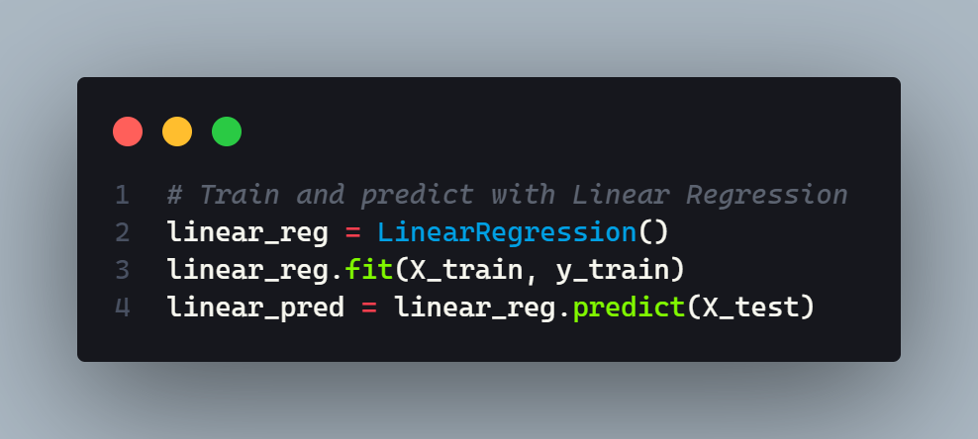
LINEAR REGRESSION
Linear Regression is a supervised machine learning algorithm used for predicting a continuous target variable based on one or more predictor variables. It assumes a linear relationship between the predictor variables(x,y,time) and the target variable (diameter). The algorithm finds the best-fit line that minimizes the sum of squared errors between the predicted and actual values.
Create Linear Regression model: A Linear Regression model is created using the LinearRegression() function from scikit-learn.
Train model: The model is trained on the training data using the fit() method. The X_train and y_train variables are passed as arguments to this method.
Make predictions: The trained model is used to make predictions on the test data using the predict() method. The X_test variable is passed as an argument to this method and the predicted values are stored in the linear_pred variable.

Slide 26
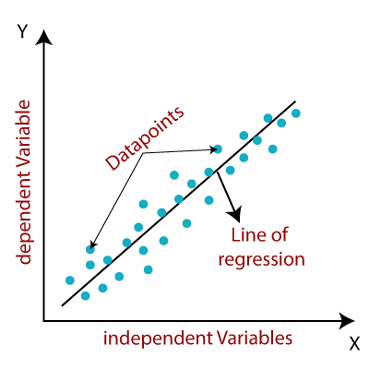
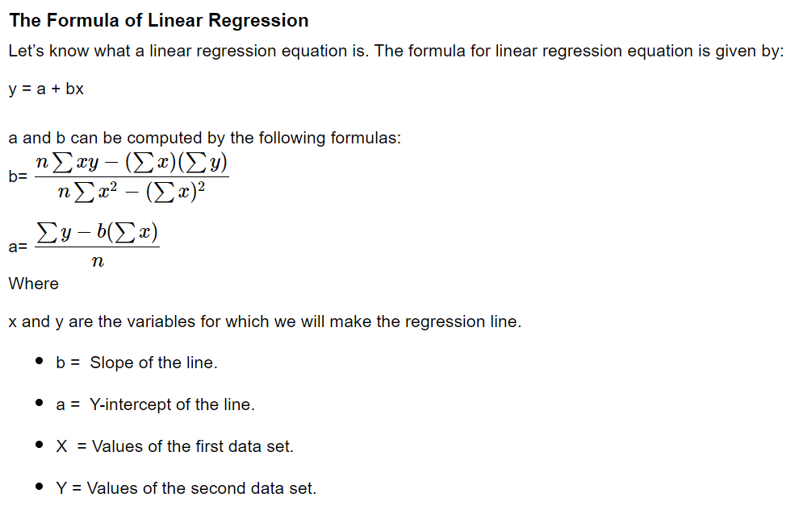

Slide 27
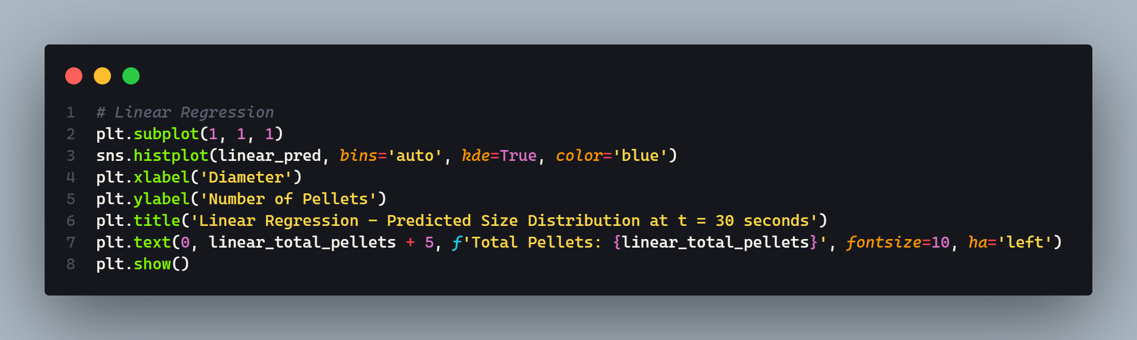
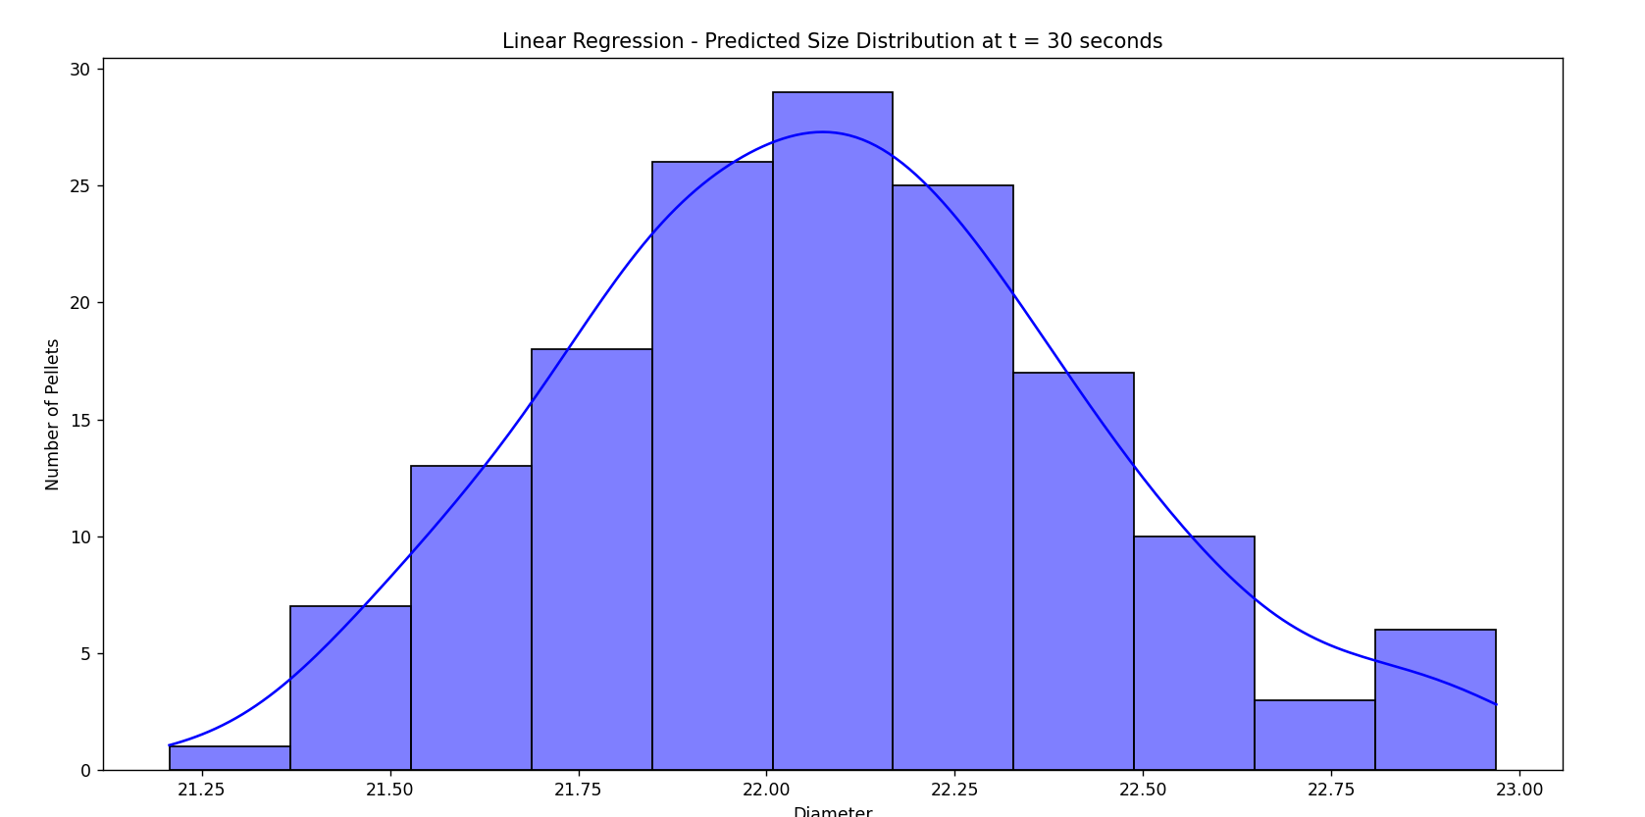

Slide 28
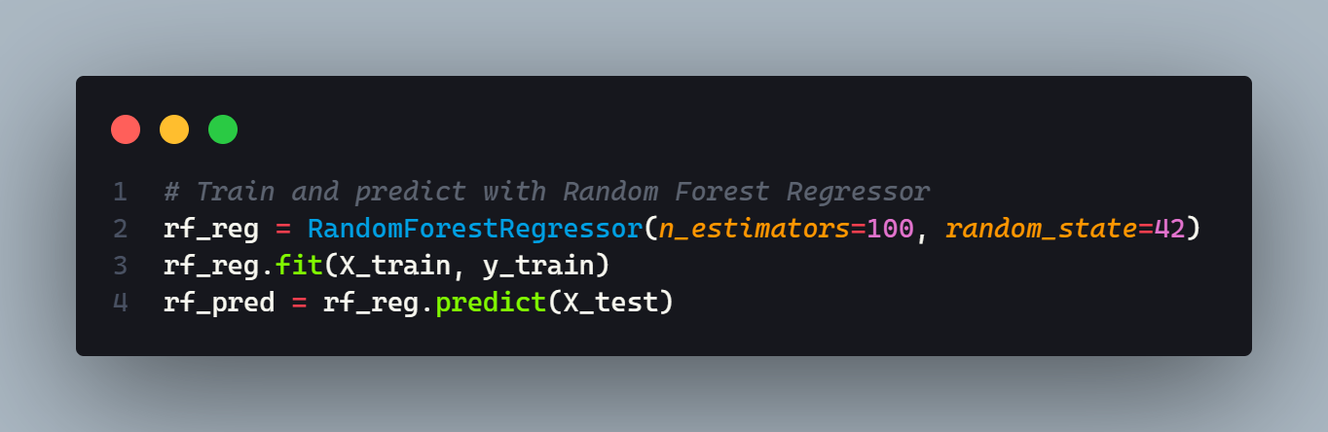
RANDOM FOREST REGRESSOR
Random Forest Regressor is a supervised machine learning algorithm used for predicting a continuous target variable based on one or more predictor variables. It is an ensemble method that combines multiple decision trees to improve the accuracy of predictions. Each decision tree in the forest is trained on a random subset of the data and makes a prediction. The final prediction is obtained by averaging the predictions of all the trees in the forest.
Create Random Forest Regressor model: A Random Forest Regressor model is created using the RandomForestRegressor() function from scikit-learn. The n_estimators parameter specifies the number of trees in the forest and the random_state parameter is set for reproducibility.
Train model: The model is trained on the training data using the fit() method. The X_train and y_train variables are passed as arguments to this method.
Make predictions: The trained model is used to make predictions on the test data using the predict() method. The X_test variable is passed as an argument to this method and the predicted values are stored in the rf_pred variable.

Slide 29
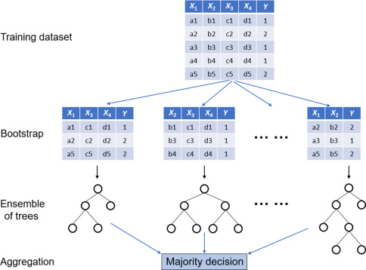
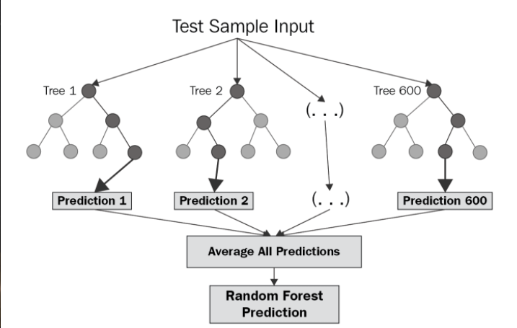
Decision Trees

Slide 30
Each tree in a Random Forest is a decision tree, which is a type of machine learning algorithm used for classification and regression. A decision tree is a flowchart-like structure where each internal node represents a test on an attribute, each branch represents the outcome of the test, and each leaf node represents a class label or a predicted value. The paths from the root to the leaf nodes represent classification rules or regression equations.
In a Random Forest Regressor, each decision tree is trained on a random subset of the data and makes a prediction. The final prediction is obtained by averaging the predictions of all the trees in the forest. This helps to reduce the variance of the predictions and improve their accuracy.
Each tree in the Random Forest is constructed using a recursive partitioning algorithm. The algorithm starts at the root of the tree and splits the data into two or more subsets based on the value of an attribute. This process is repeated recursively for each subset until all the data in a subset belongs to the same class or meets some other stopping criterion.
The attribute to split on at each node is chosen based on some measure of impurity, such as Gini impurity or information gain. The goal is to choose an attribute that results in the greatest reduction in impurity. Once all the trees in the forest have been constructed, they can be used to make predictions on new data.
In many Data Analytics Companies Random Forest Algorithm is their most used supervised machine learning algorithm for classification or regression problems because of its accuracy, robustness, feature importance, ease of use and low variance.

Slide 31
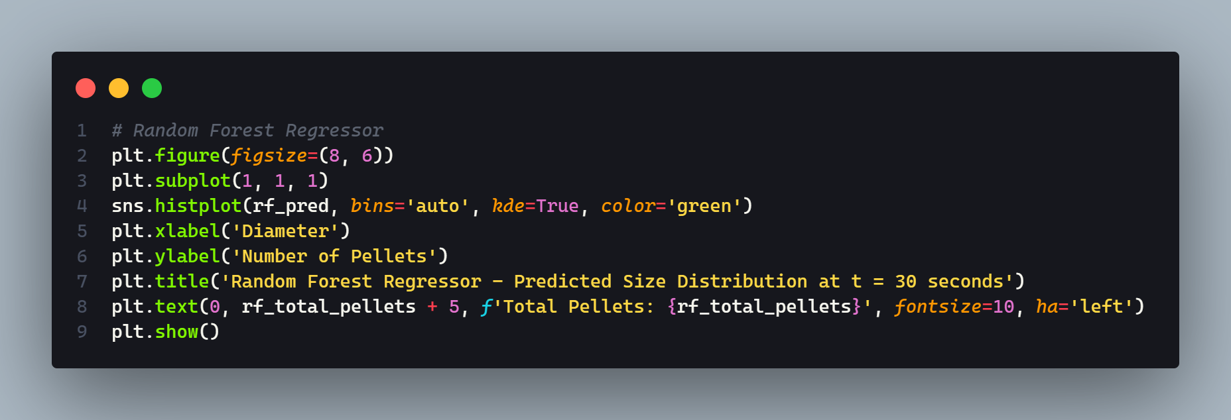
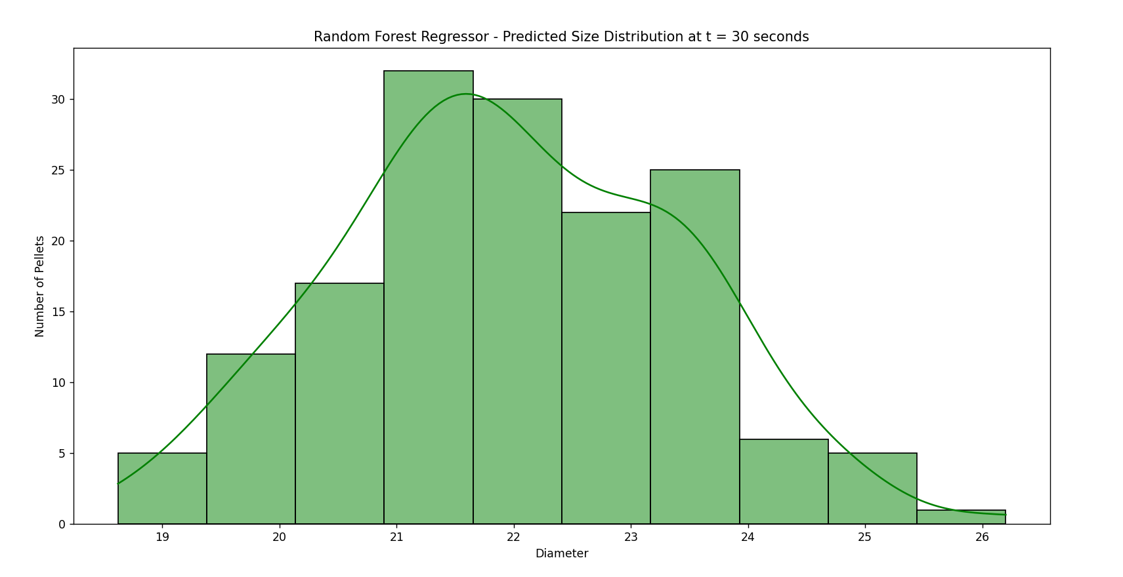

Slide 32
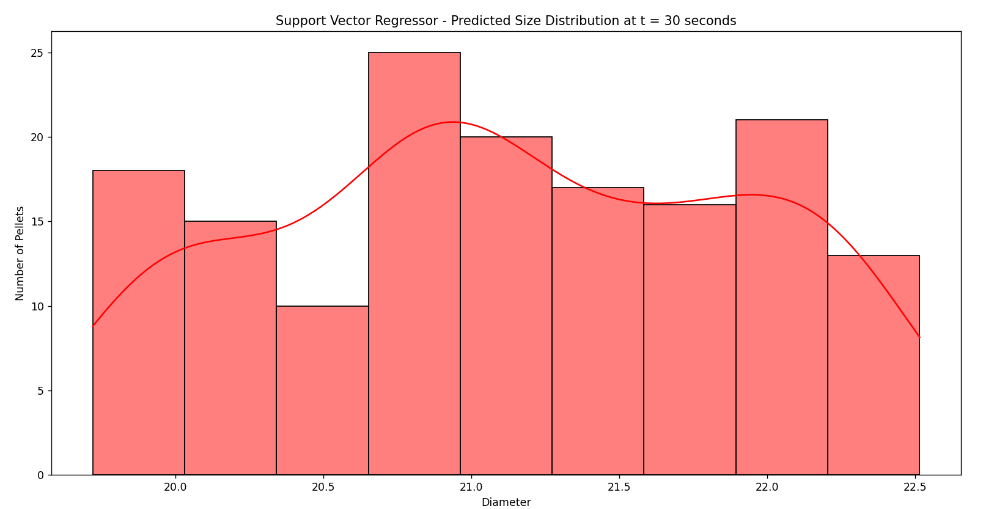
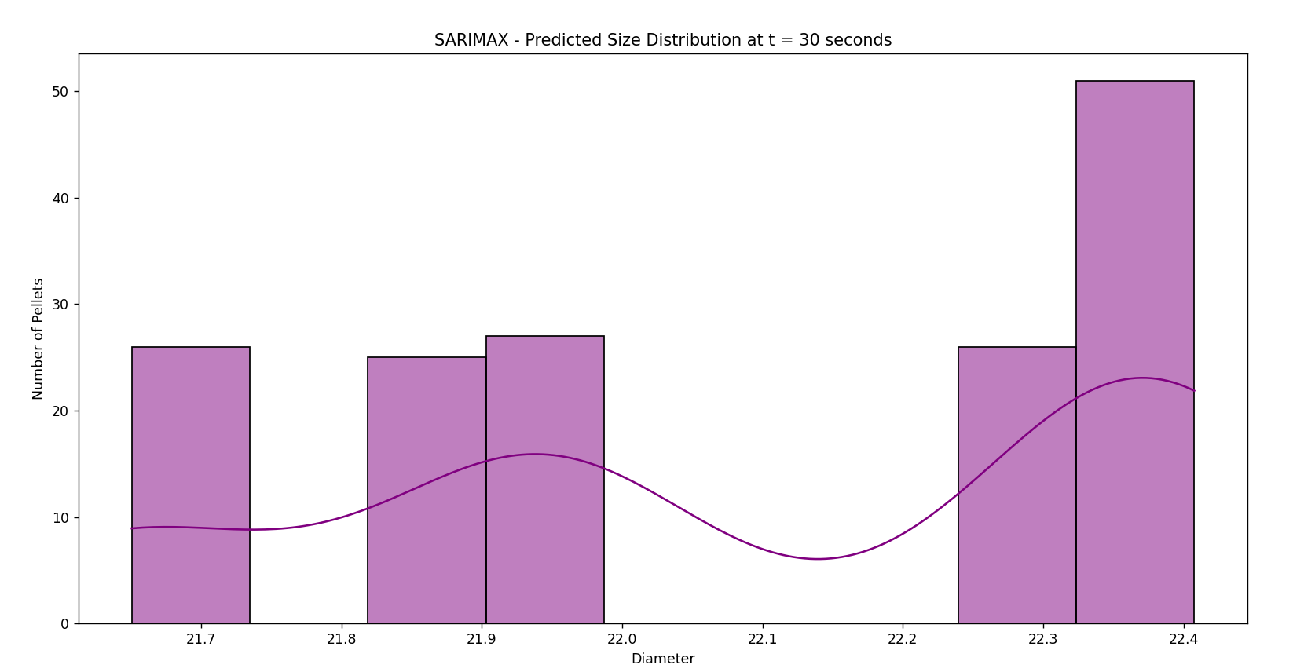
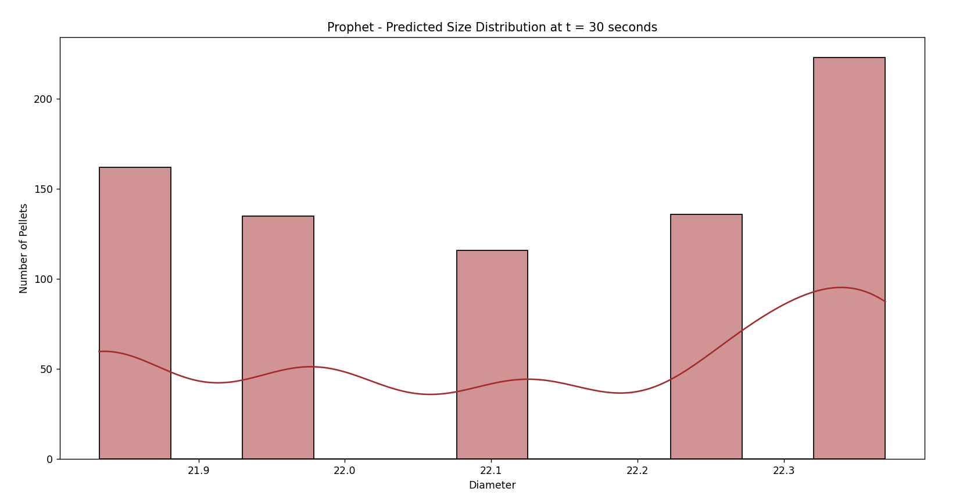
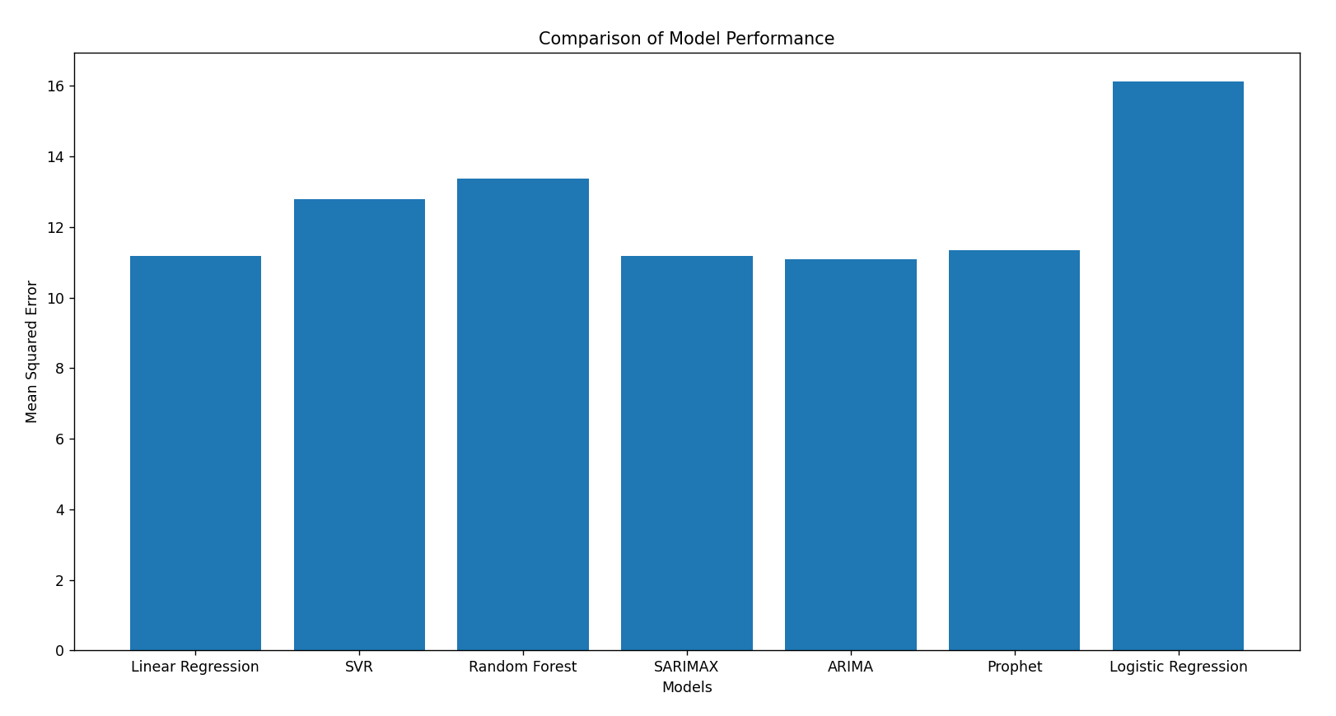

Slide 33
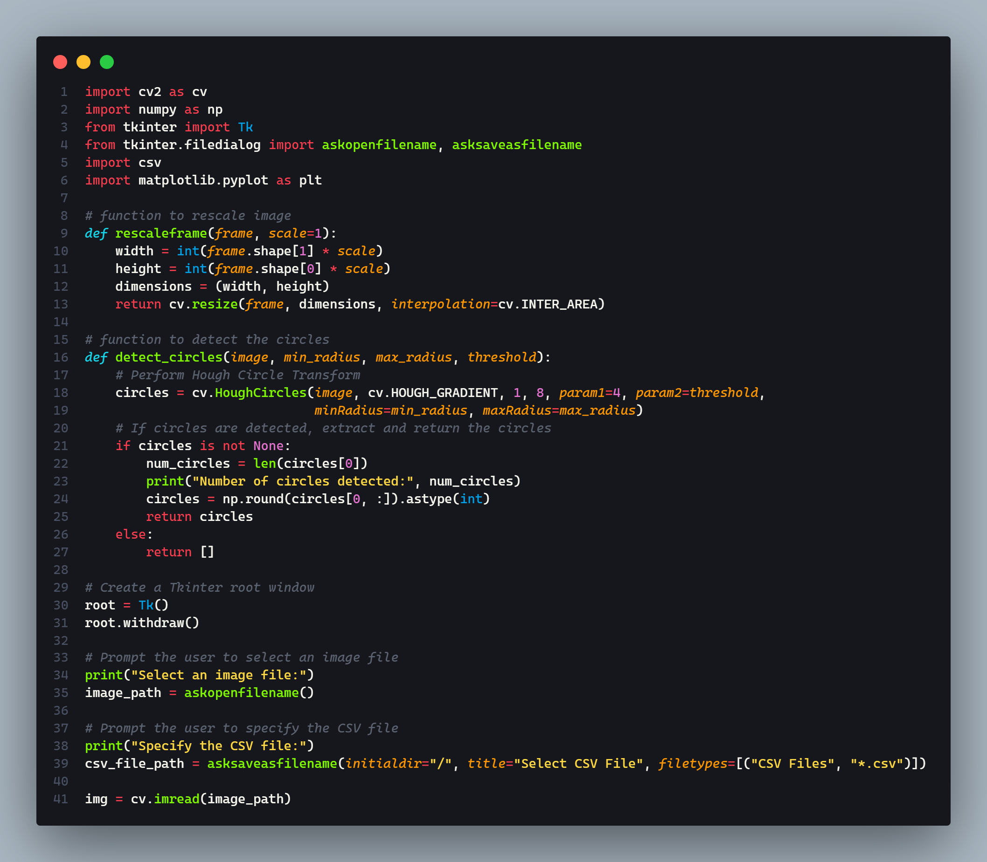
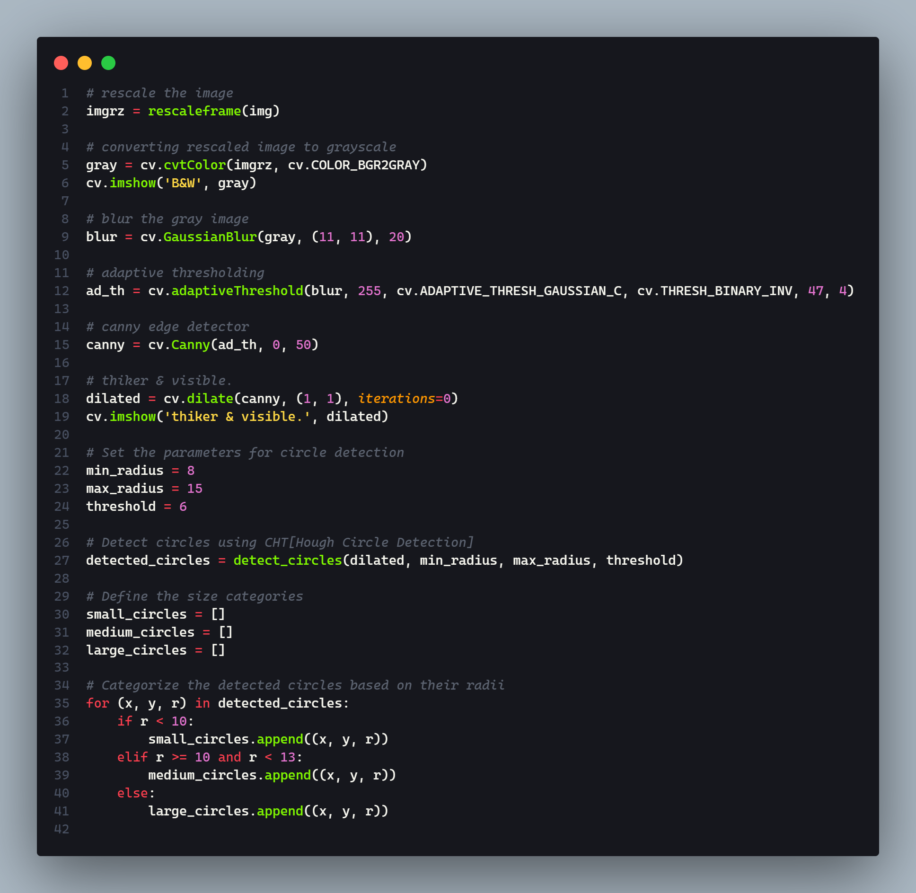
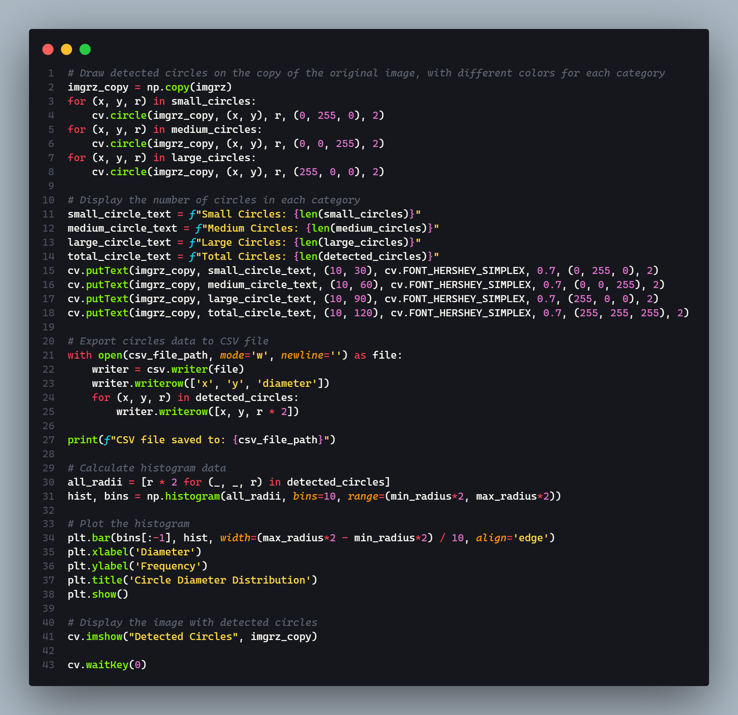
APPENDIX
PART 1: FULL CODE OF IMAGE PROCESSING AND .CSV FILE EXPORT OF PELLET SIZES AND COORDINATES

Slide 34
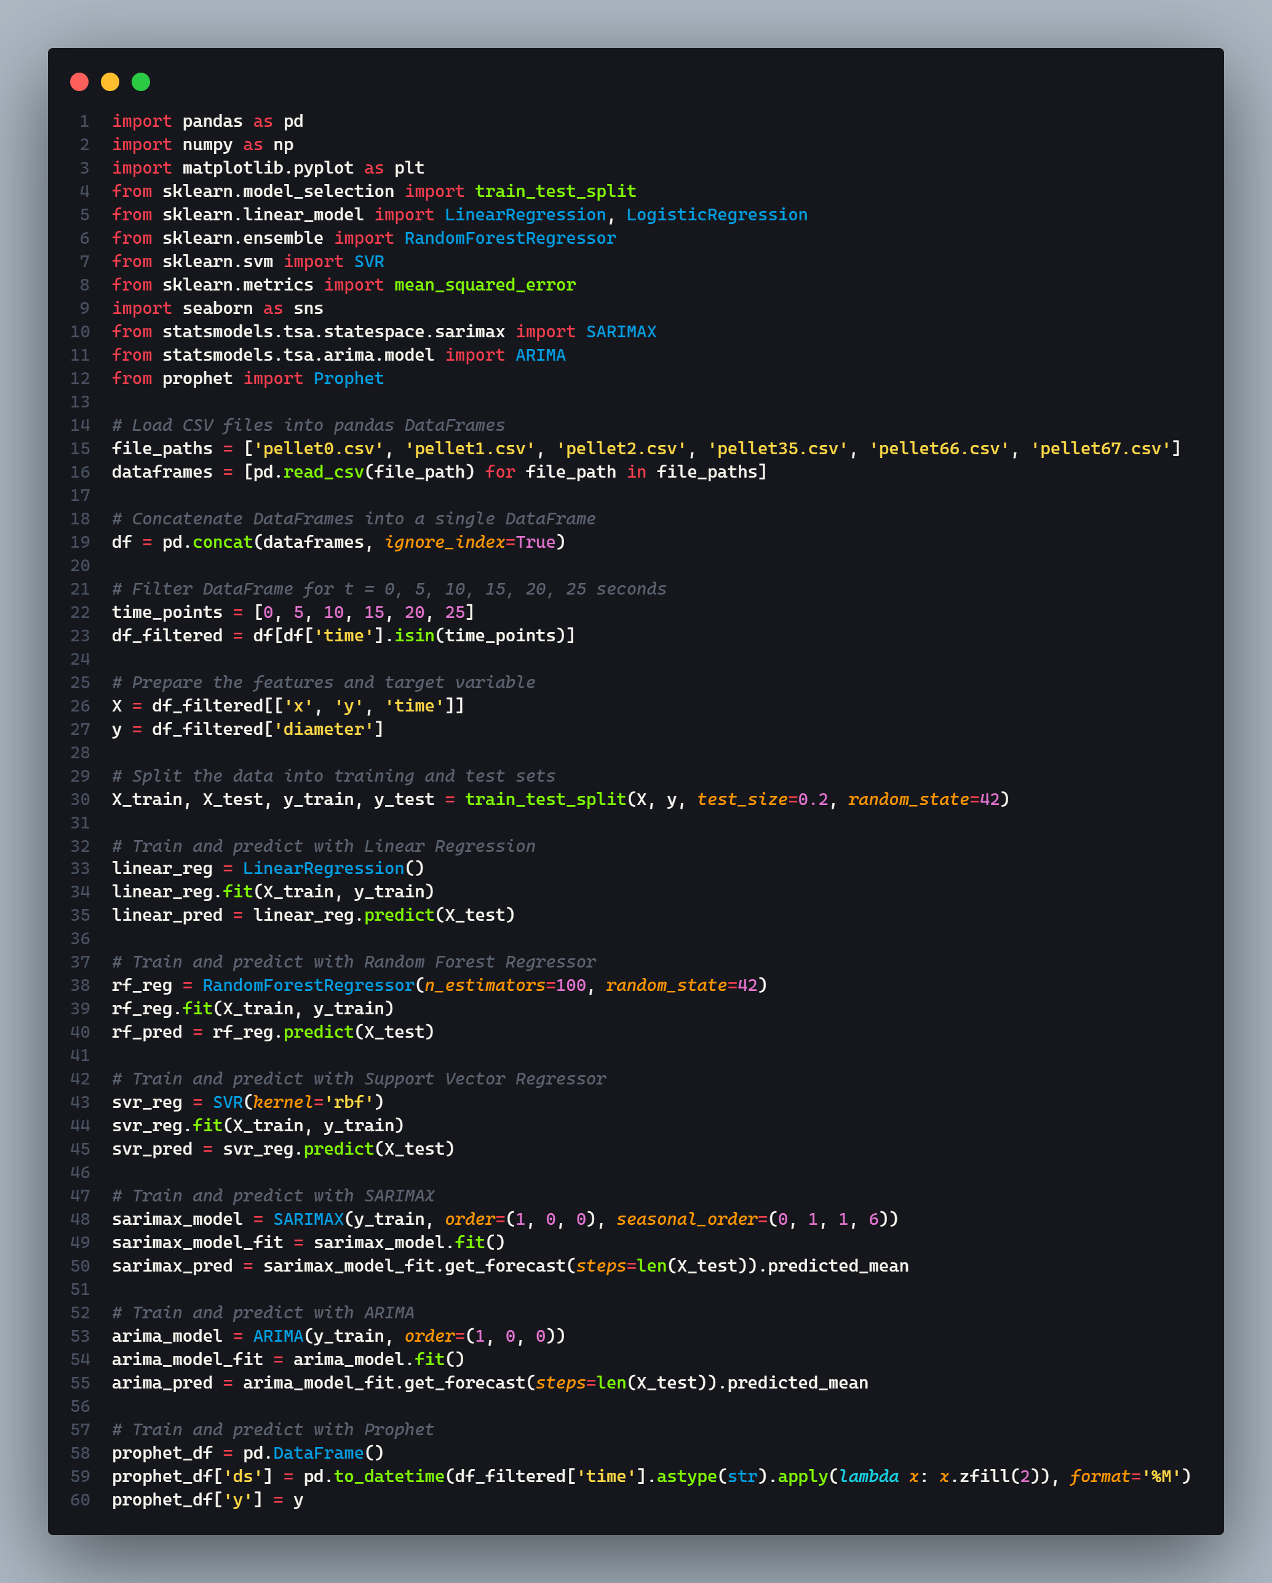


PART 2: FULL CODE OF MACHINE LEARNING AND TIME SERIES PREDICTION
Both the parts of the codes performing Image Processing and Machine Learning can be concatenated into a single source code with minor changes for taking pellet images with time stamps as input, detecting pellets, their sizes and coordinates, converting them to Pandas Data Frames in backend and directly giving as the predicted size charts at given time using all the relevant models for comparison by Industry engineers.

Slide 35


